Slide 1
Udacity Data Analyst Nanodegree Program
Name: Mohmmad Alwakeel
Project 1

Slide 2
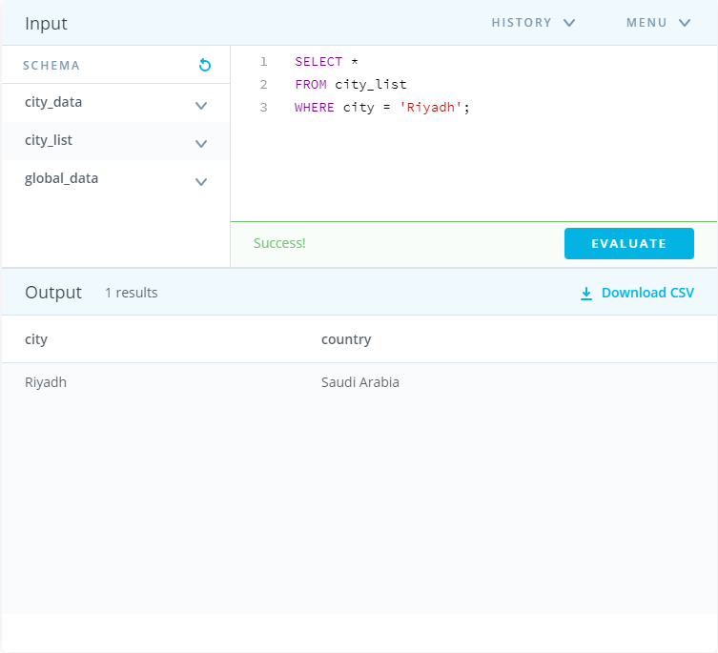
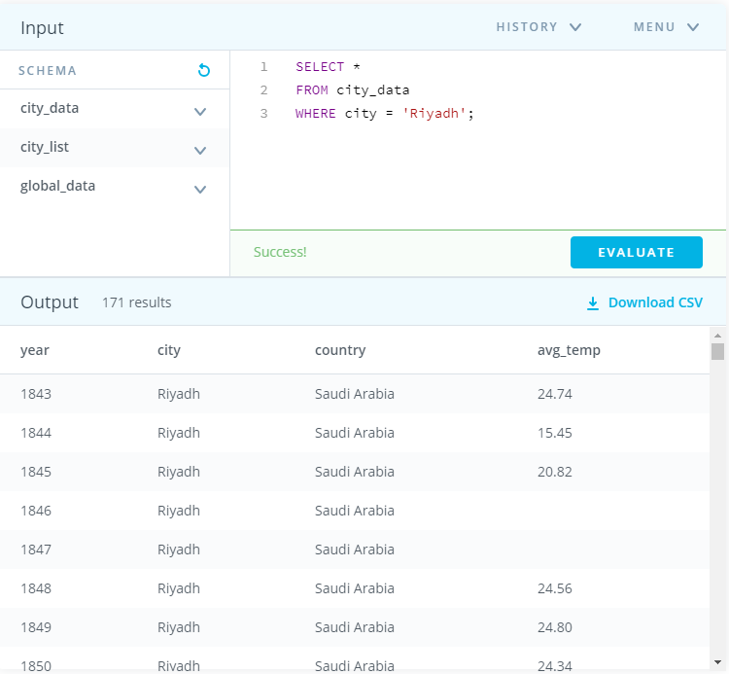
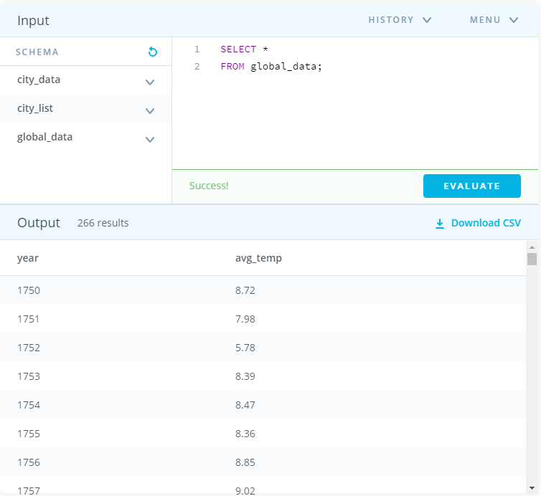
Tools used in this project:
SQL : -
The SQL language was the main tool for extracting data. At the first, code1 (figure 1) was used to make sure that the city where I live is listed. Then I used code2 (figure 2) to extract the average temperature over years in Riyadh, the city where I live. Furthermore, code3 (figure 3) was used to extract the average global temperature over years. All of which data where downloaded as (CSV).
Figure 1
Figure 2
Figure 3

Slide 3
Tools used in this project:
Excel:-
MS Excel was used in this project to clean, organize, group, and visualize data.
At the beginning I combined the two CSV spreadsheet files downloaded from the previous step, after that I organized and identified the data with colors and names. Also, some functions were used to figure out the minimum and maximum temperatures.
After, I continued my work to find the moving average, I used two methods to do it, both of them has equal observation result.
The first method is Pivot Table. I used it twice for global_years and avg_temp_global columns, and for city_years and avg_temp_global columns, each of which in a separate spreadsheet, where I moved years into rows and temperature into values.
Furthermore, to calculate the moving average and to smooth out the line chart. The option (Group) was used in order to aggregate the values of each ten years in a single row. Then, the summarization of values cells where changed from (SUM) to (AVG) in the field option.
The second method was identical to the method mentioned in Udacity, where I took the average for each 7 continuous years together.
Finally, At the end, I visualized each sheet with a line chart.
* I’ll be attaching the (CSV file).

Slide 4
Observations:
Is Riyadh hotter or cooler on average compared to the global average? Has the difference been consistent over time?
As illustrated in the graphs, the average temperatures in Celsius over years in my city “Riyadh” is way higher than the global average. Even though the consistency of the average temperatures in Riyadh did fluctuate at the beginning and the end. However, the minimum reached nearly 24.5°C where it’s higher than the highest point on the global average.

Slide 5
Observations:
How do the changes in Riyadh's temperatures over time compare to the changes in the global average?
As shown in the graphs, the changes in my city “Riyadh” has more fluctuation than the changes of global . However, both of which has a rising change over years as the trade line shows.

Slide 6
Observations:
What does the overall trend look like? Is the world getting hotter or cooler? Has the trend been consistent over the last few hundred years?
As shown in the graphs, both of which has a rising trend of average temperatures over years as the trade line shows. For instance, the global’s temperature used to be 8°C between 1843 and 1852 where in 2015 it reached the maximum with nearly10°C. On the other hand, Riyadh’s temperature was around 24°C between 1843 and 1852, but in 2013 it reached the peak with nearly 27°C. All of the previous evidences pinpoint that the world is becoming hotter over the years. Also we can interfere from the graphs that the rising over the past hundred years was consistent.

Slide 7
Observations:
What is the maximum and minimum temperature reached in both Riyadh and the global? In which years these temperatures were?
As the graphs and the data explains, the global’s temperature has a minimum of 7.65°C in 1844, where in 2015 it reached the maximum with 9.83°C. On the other hand, Riyadh’s temperature reached it’s lowest in 23.77°C in 1862, where in 2013 it reached the peak with 27.73°C.

Slide 8
The End

